Slide 1
19CCE495 PROJECT PHASE - 1
Review 2.1 - Progress
Batch ID: ECE004
Cloud Intrusion Detection System using eXplainable AI
CB.EN.U4CCE22024 - IVANA FREDERIC
CB.EN.U4CCE22025 - JANANI S V
CB.EN.U4CCE22062 - HARISH R
MENTOR:
Dr. Ramanathan R. Department of Electronics and Communication Engineering Amrita School of Engineering, Coimbatore

Slide 2
Outline
Motivation
Problem Statement
Objectives
Literature Survey
Milestones and Deliverables
Methodology
Results and Discussion
Validation and Testing
Conclusion
References

Slide 3
Motivation
As more people and businesses embrace cloud technology, the risk of cyberattacks is growing rapidly.
Need for powerful and smart security solutions to protect our valuable data and build trust
References: [1], [2]

Slide 4
Problem Statement
Although ML and DL-based IDSs demonstrate strong performance in detecting threats, their black-box nature limits transparency and interpretability , thus our project addresses the problem by enhancing explainability of results.
References: [3]

Slide 5
Objectives
To extract and select key features from dataset.
To test the system on real-world datasets and provide insights on the potential threats.
To build a simple user interface to display results and their corresponding explanations.
To implement eXplainable AI approach for the Cloud Intrusion Detection system.

Slide 6
Literature Survey
S. No | Paper Title | Year of Publication | Inferences | Future scope/ Relevance to proposed work
1. | Automatic Evasion of Machine Learning-Based Network Intrusion Detection Systems [4] Publisher: IEEE Transactions on Dependable and secure Computing | 2024 | Proposes practical and automated black-box evasion attack Attack strategy involves three steps: model extraction, local white-box attack, and black-box transfer attack Evaded seven typical ML-based IDSs and one state-of-the-art (SOTA) Deep Learning (DL)-based IDS (Kitsune) with an average success rate of over 75% | Need for effective defenses against such evasion attacks Need to explore more accurate and lower-cost model extraction and evasion detection techniques Suggests applying adversarial examples to broader traffic-related problems beyond just IDS

Slide 7
S. No | Paper Title | Year of Publication | Inferences | Future scope/ Relevance to proposed work
2. | Explainable Intrusion Detection for Cyber Defences in the Internet of Things: Opportunities and Solutions [5] Publisher: IEEE Communications and Surveys Tutorials | 2023 | Comprehensive review of Explainable Artificial Intelligence (XAI) techniques for anomaly-based intrusion detection in IoT networks, emphasizing the need for transparency and trust in DL models Benefits of XAI in cybersecurity -model debugging, guiding data collection, supporting human decision-making, and building trust in AI systems Black-box nature – hinders security experts’ confidence | Focus on achieving a better balance between explainability and detection efficiency in XAI models Need to develop quantifiable and standardized assessment metrics for XAI in IoT and to standardize XAI terminology for DL models Identifies a research gap in creating new XAI methods specifically for IDSs and evaluating existing ones

Slide 8
S. No | Paper Title | Year of Publication | Inferences | Future scope/ Relevance to proposed work
3. | Interpretable Machine Learning for Mitigating Feature-Driven Attacks [6] Publisher: IEEE Transactions on Technology and Society | 2025 | Addresses the problem of bias and over-reliance on a few "key" features in Machine Learning (ML) models used for malicious document detection, which can be exploited by feature-driven attacks Splitting features based on their SHAP magnitude (influence on classification) and training separate ML models on these subgroups Informs the user when insufficient features are present for a confident classification | Test this technique on larger, more representative datasets to confirm its scalability and robustness Suggests exploring alternative interpretability algorithms to SHAP to identify any potential biases introduced by the interpretability method itself

Slide 9
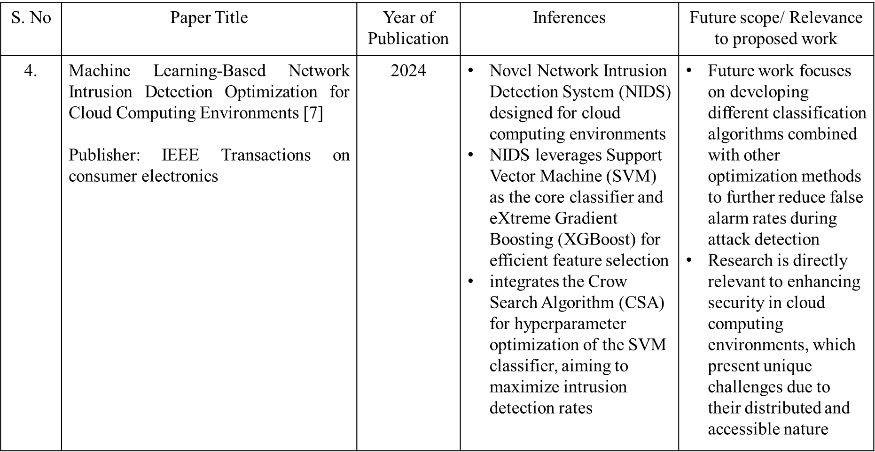

Slide 10
S. No | Paper Title | Year of Publication | Inferences | Future scope/ Relevance to proposed work
5. | Network Intrusion Detection and Comparative Analysis Using Ensemble Machine Learning and Feature Selection [8] Publisher: IEEE Transactions on Network and Service management | 2022 | Comprehensive Machine Learning (ML)-based security solution for network intrusion detection using an ensemble supervised ML framework (SupEnML) and ensemble feature selection (EnFS) methods Ensemble classification models demonstrated superior performance, outperforming single models in over 85% of the experiments | Incorporating the full amount of data and new datasets (including from other domains) to further verify the method's efficiency Highly relevant for designing robust and generic Intrusion Detection Systems (IDSs) by optimizing feature selection and leveraging ensemble techniques

Slide 11
S. No | Paper Title | Year of Publication | Inferences | Future scope/ Relevance to proposed work
6. | Recent Advances in Trustworthy Explainable Artificial Intelligence: Status, Challenges, and Perspectives [9] Publisher: IEEE Transactions on Artificial intelligence | 2022 | comprehensive survey of XAI, covering its design, development, goals, evaluation, and security. Discusses key XAI goals Categorizes XAI methods Outlines measures for evaluating XAI systems | Trade-off between model performance and interpretability Provides theoretical foundation and broad overview of XAI Emphasizes the need for XAI systems Validates the choice of SHAP as a feature relevance explanation method

Slide 12
7. | Explainable Intrusion Detection Systems (X-IDS): A Survey of Current Methods, Challenges, and Opportunities [10] Publisher: IEEE Access | 2022 | Surveys the SOTA in XAI for IDS Proposes generic X-IDS architecture Highlights the difficulties of black - box models Exemplifies the absence of standard metrics for XAI systems Highlights concerns on security aspects | Provides emphasis for our project idea, and the need of it in the hour Directly mentions SHAP and LIME as common explainers for black-box models Depicts the importance of result validation Future concerns include optimization of X-IDS for scalability
8. | An Improved Design for a Cloud Intrusion Detection System Using Hybrid Features Selection Approach with ML Classifier [11] Publisher: IEEE Access | 2023 | Proposes improved cloud IDS design SMOTE Hybrid Feature selection approach – IG, CS, PSO Employs random forest model IDS with fewer informative features are efficient | Importance of effective feature selection Validates the use of the ML models Proof that the taken datasets are reliable Suggests ensemble learning concepts

Slide 13
9. | E-XAI: Evaluating Black-Box Explainable AI Frameworks for Network Intrusion Detection [12] Publisher: IEEE Access | 2024 | Proposes end-to-end evaluation framework for SHAP & LIME in IDS Uses metrics and tests on several models Highlighted strengths & weaknesses of black-box XAI in IDS | Directly aligns with your use of SHAP & LIME for explaining IDS decisions. Supports the project’s focus on trust, transparency, and explanation validation. Helps justify the model choices for efficiency
10. | Explainable Artificial Intelligence (XAI) for Malware Analysis: A survey of Techniques, Applications, and Open Challenges [13] Publisher: IEEE Access | 2025 | Surveyed ML techniques (2018–2024) for malware analysis with focus on XAI. Categorized and reviewed XAI framework Lack of interpretability in traditional ML limits real-world use. Many datasets are outdated, imbalanced | Develop updated, balanced malware datasets. Strong foundation for XAI’s role in cybersecurity . Supports the use of SHAP & LIME for local/global explanations. Highlights and reinforces the dataset challenges supporting SMOTE and feature selection processes Future work of the paper includes improving model-agnostic tools.

Slide 14
Review 1.3 : October – November 2025
Milestones and Deliverables: October - November 2025
Integrate SHAP and LIME to explain model outputs
Visualize why an instance is considered “normal” or an “attack”
Validate explanations with example traffic cases

Slide 15
Review 2.1: December 2025 – January 2026
Milestones and Deliverables: December 2025 - January 2026
Build a simple Flask-based dashboard to create a user interface to display Real-time IDS prediction
Feature importance visualization to be performed using SHAP
Integrate model and XAI modules into the dashboard and validate user experience

Slide 16
Methodology
1. Data Preprocessing for both UNSW-NB15 and CICIDS 2017 Datasets
1.1 Handling Missing Values – Numeric Values : Median, Categorical Data : Label Encoding
1.2 Feature Normalization – Min-Max Scaling
1.3 SMOTE
Hybrid Feature Selection – Information Gain, Chi-Square, Cuckoo Search
Model Training – Random Forest and XGBoost
Model Evaluation – Accuracy, Precision, Recall, F1- Score
XAI Integration – LIME and SHAP
Creation of User Interface
Testing and Validation
References: [1], [2], [13], [14], [15]

Slide 17
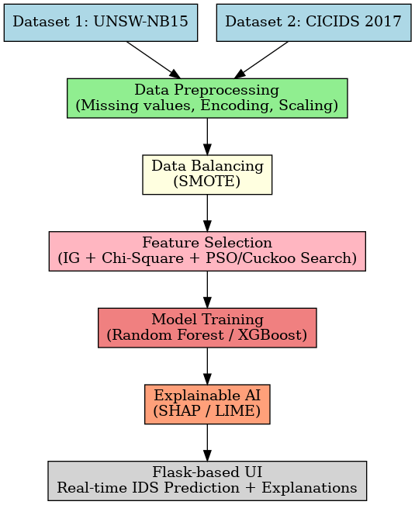
Block Diagram
Fig. 1. Methodology Block Diagram

Slide 18
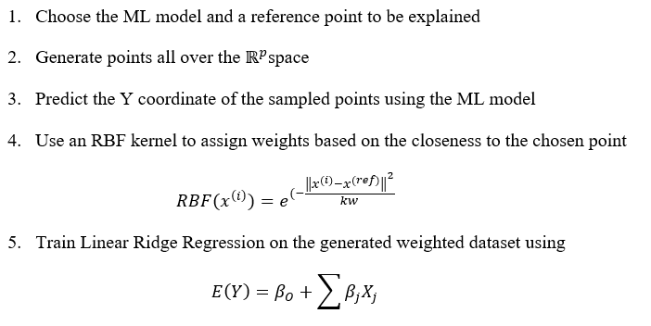
LIME Algorithm

Slide 19
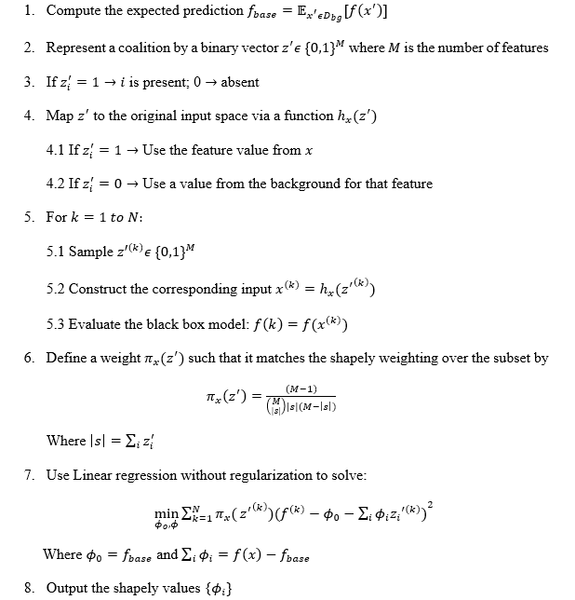
SHAP Algorithm

Slide 20
Results and Discussion

Slide 21
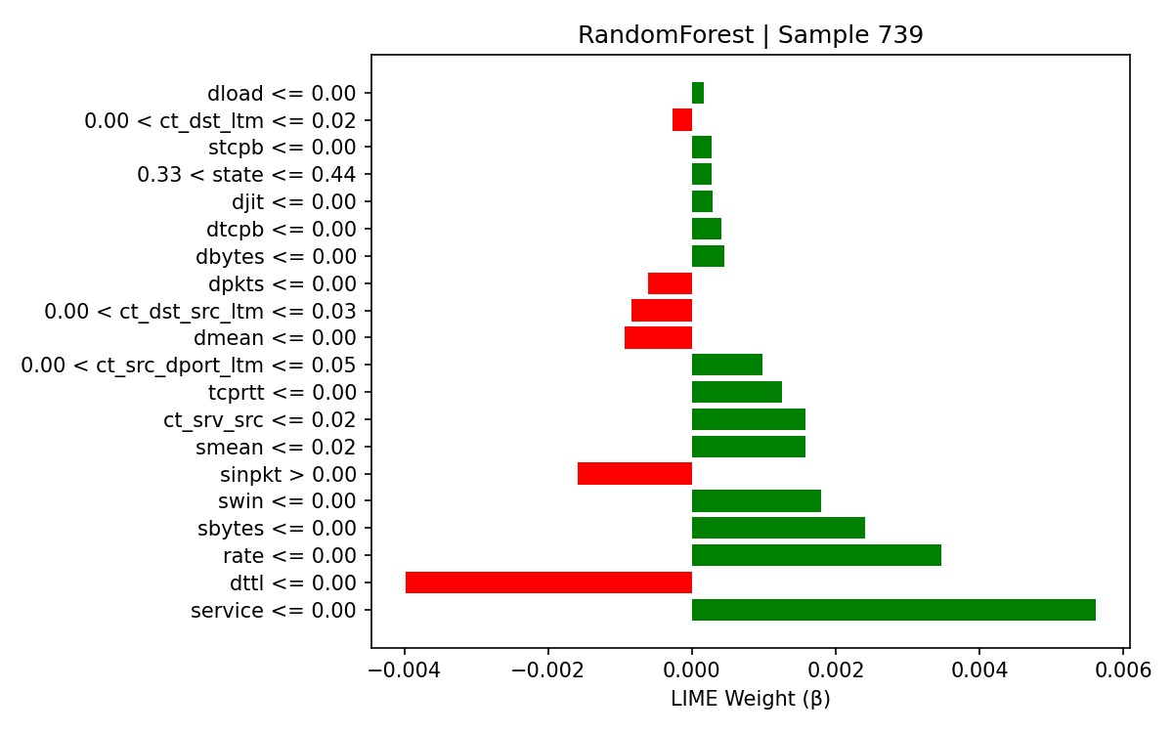
Recap – Review 1.3
UNSW-NB15 – LIME for Random Forest
Fig. 1. LIME Explanation for sample 739 -

Slide 22
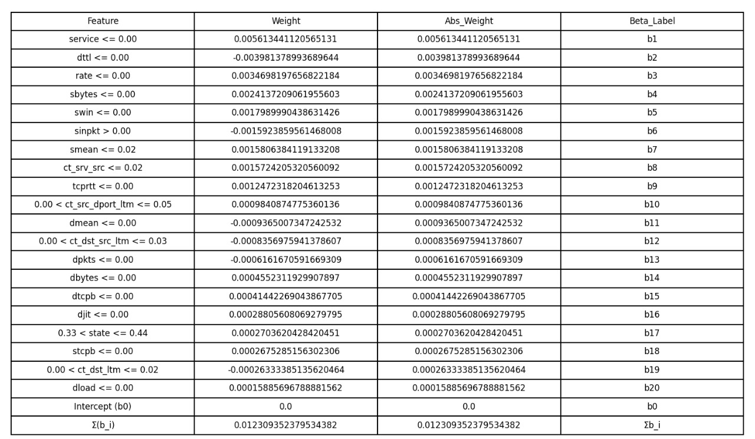
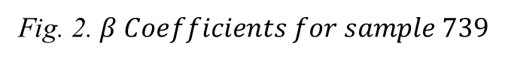
Fig. 2. $β Coefficients for sample 739$

Slide 23
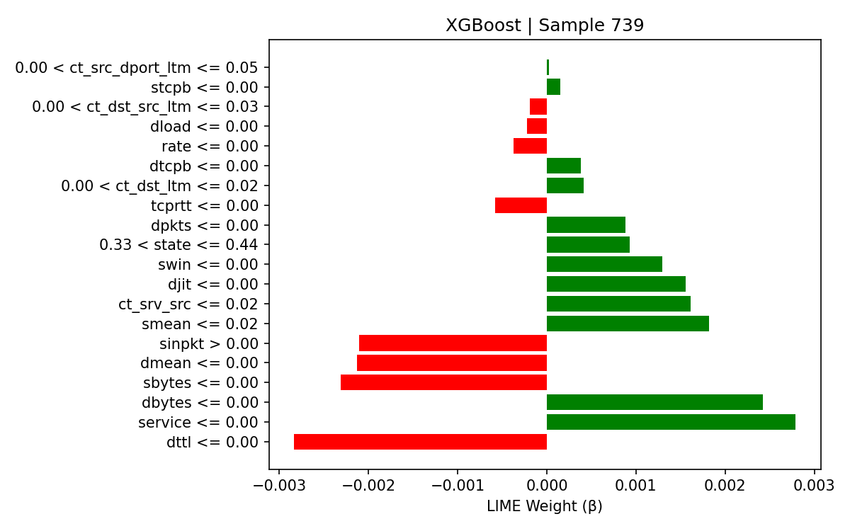
UNSW-NB15 – LIME for XGBoost
Fig. 3. LIME Explanation for sample 739

Slide 24
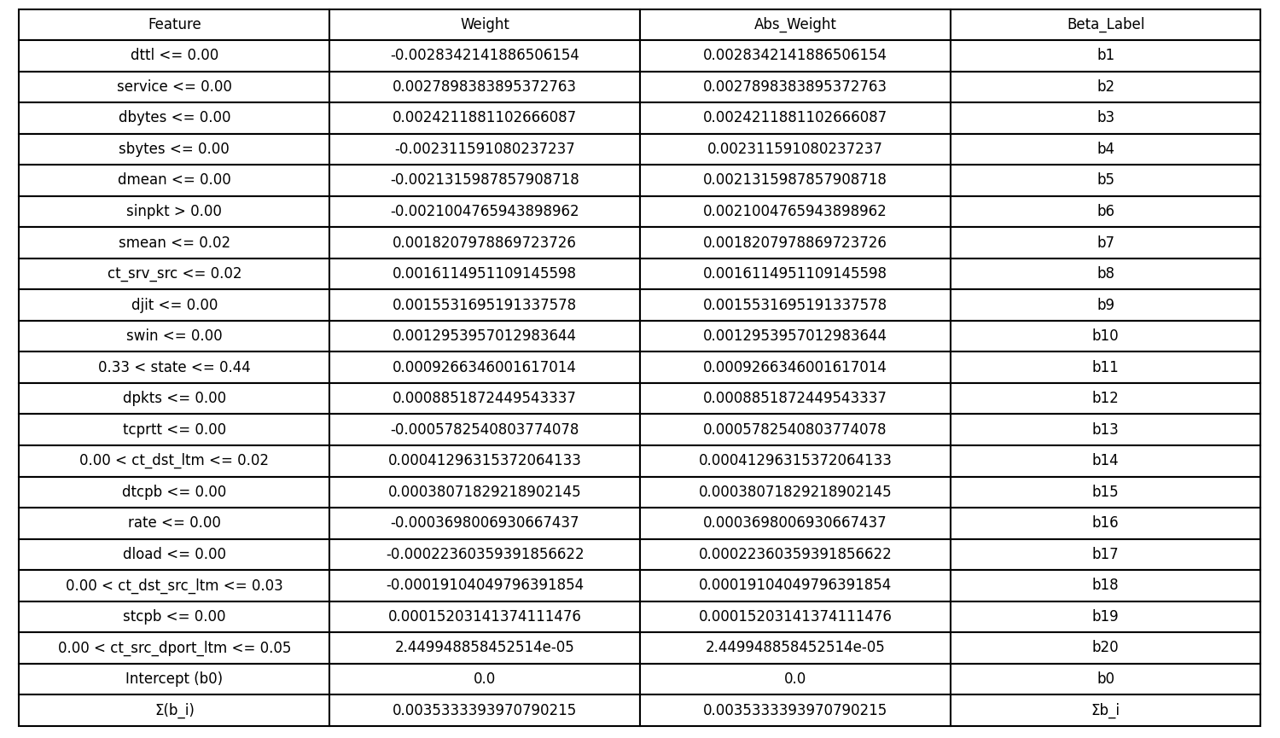
Fig. 4. LIME Explanation for sample 739

Slide 25
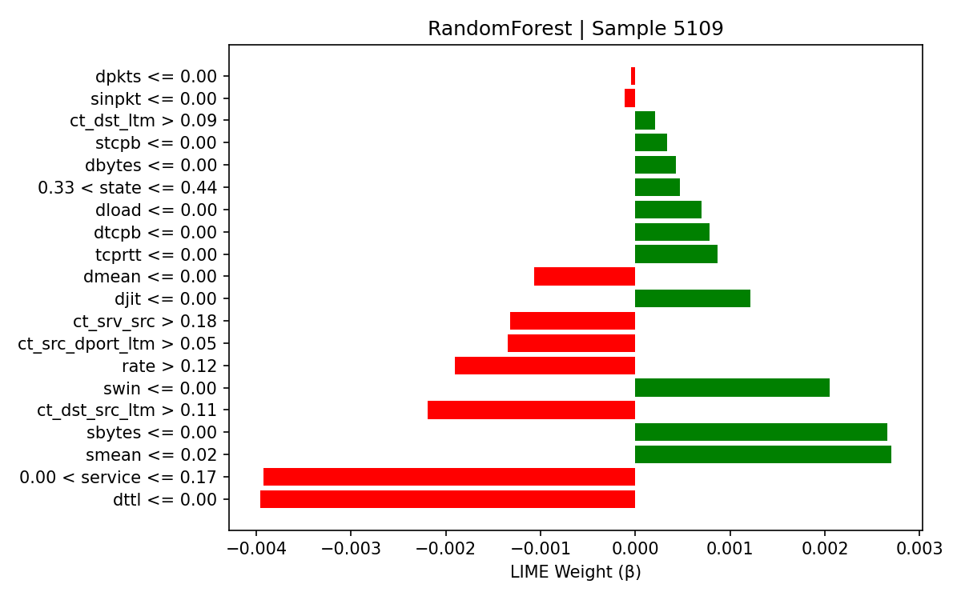
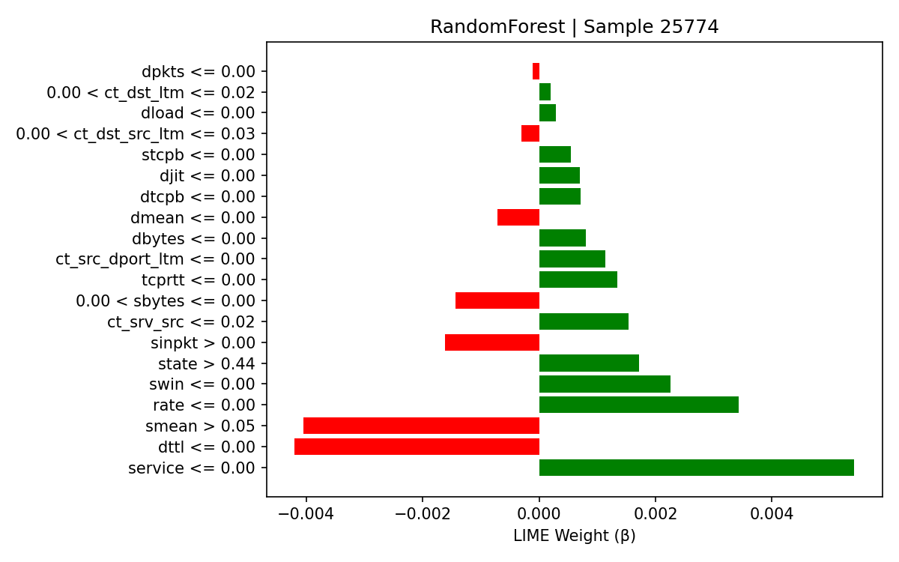
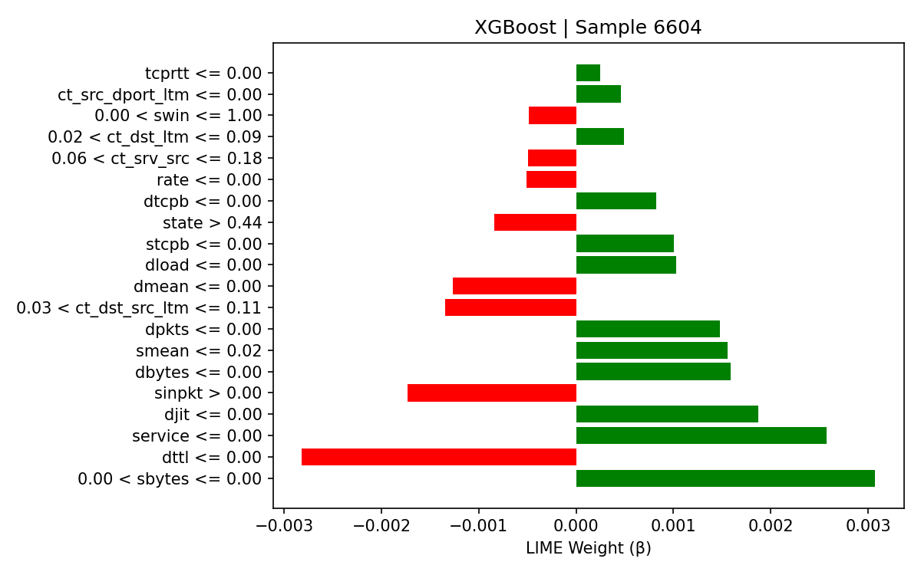
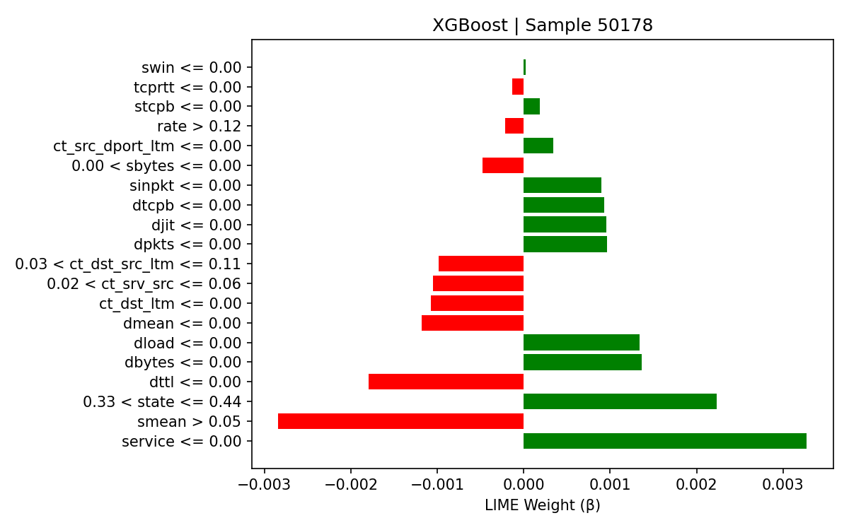
Example traffic cases LIME

Slide 26
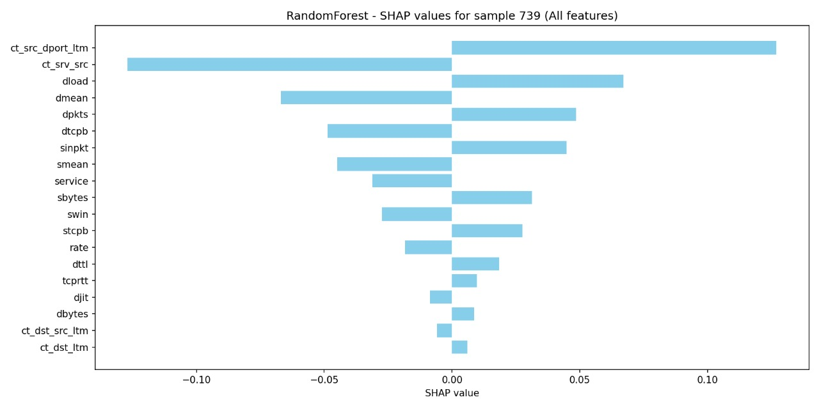
UNSW-NB15 – SHAP for Random Forest
Fig. 5. SHAP explanation for sample 739

Slide 27
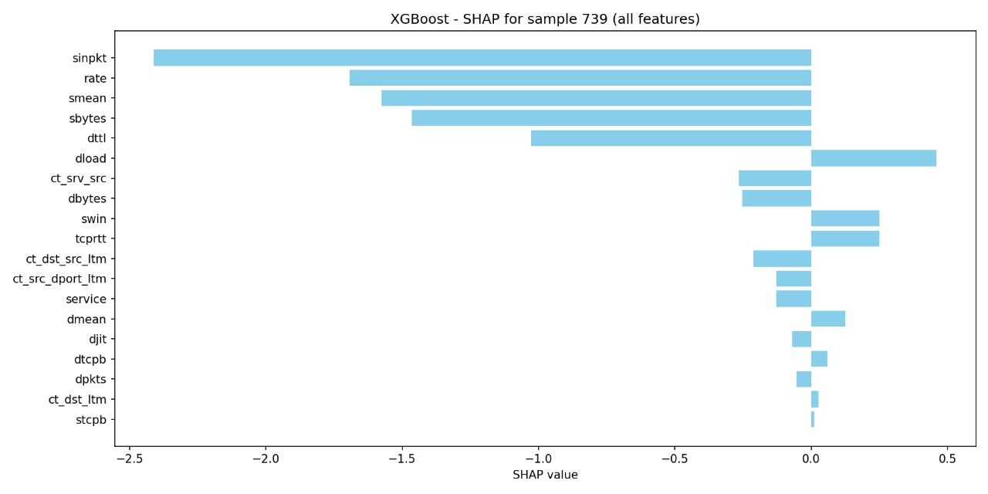
UNSW-NB15 – SHAP for XGBoost
Fig. 6. SHAP Explanation for sample 739

Slide 28
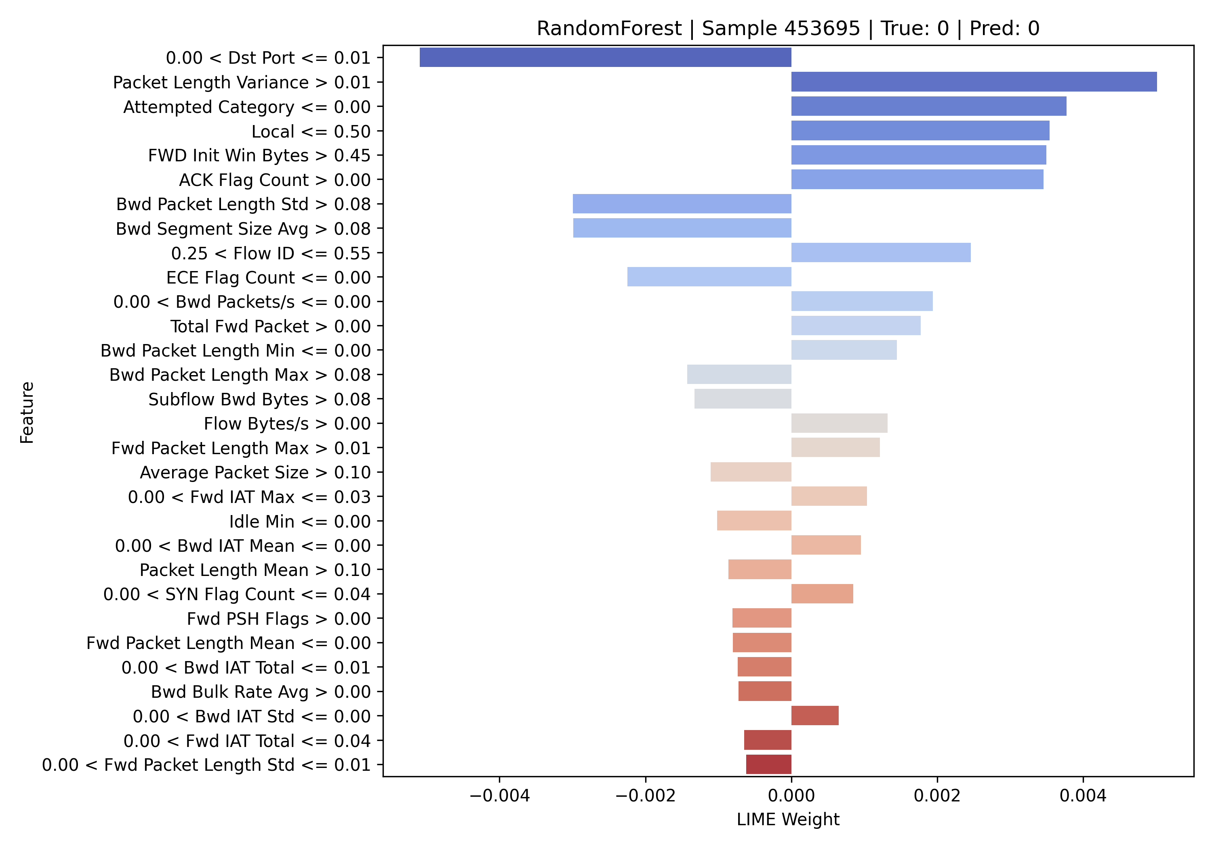
CICIDS 2017 – LIME for Random Forest
Fig. 7. LIME Explanation for sample 45369

Slide 29
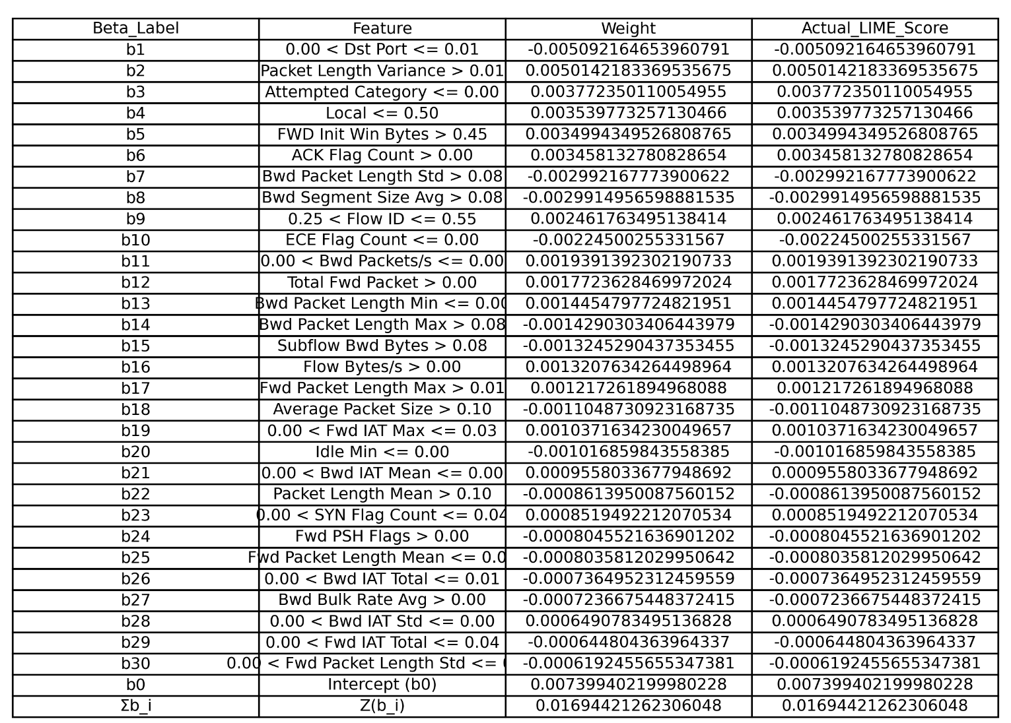
Fig. 8. LIME coefficients for sample 45369

Slide 30
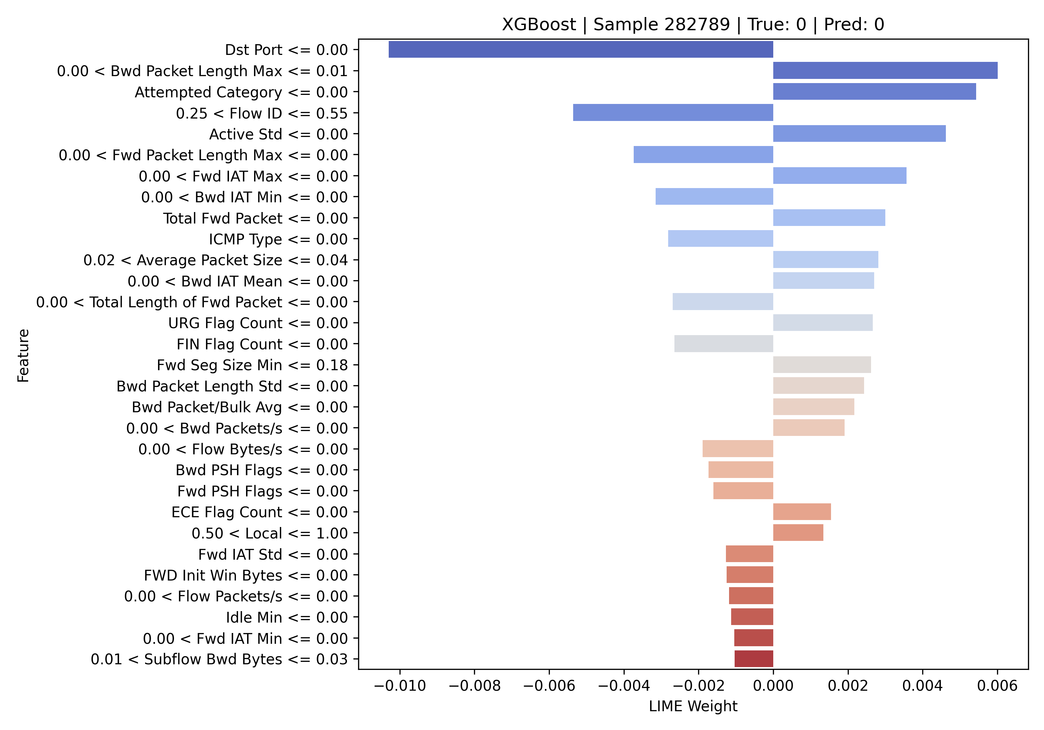
CICIDS 2017 – LIME for XGBoost
Fig. 9. LIME for sample 282789

Slide 31
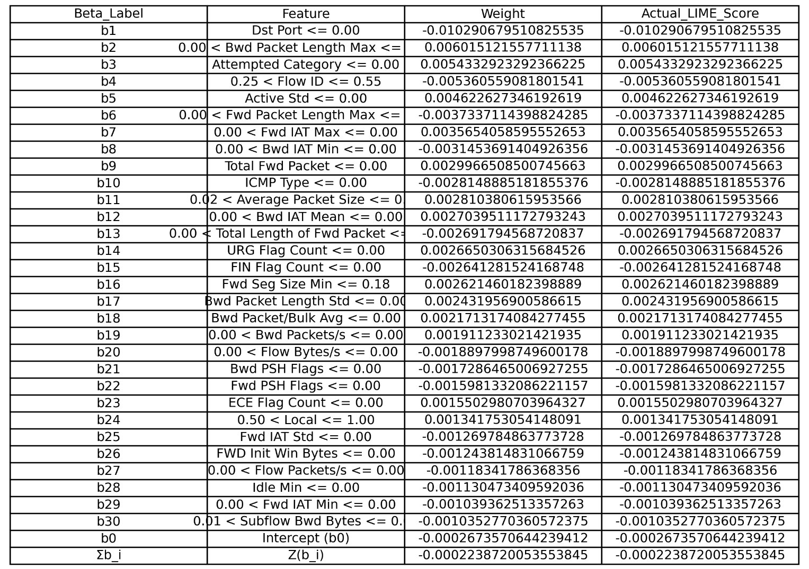
Fig. 10. LIME Coefficients for sample 282789

Slide 32
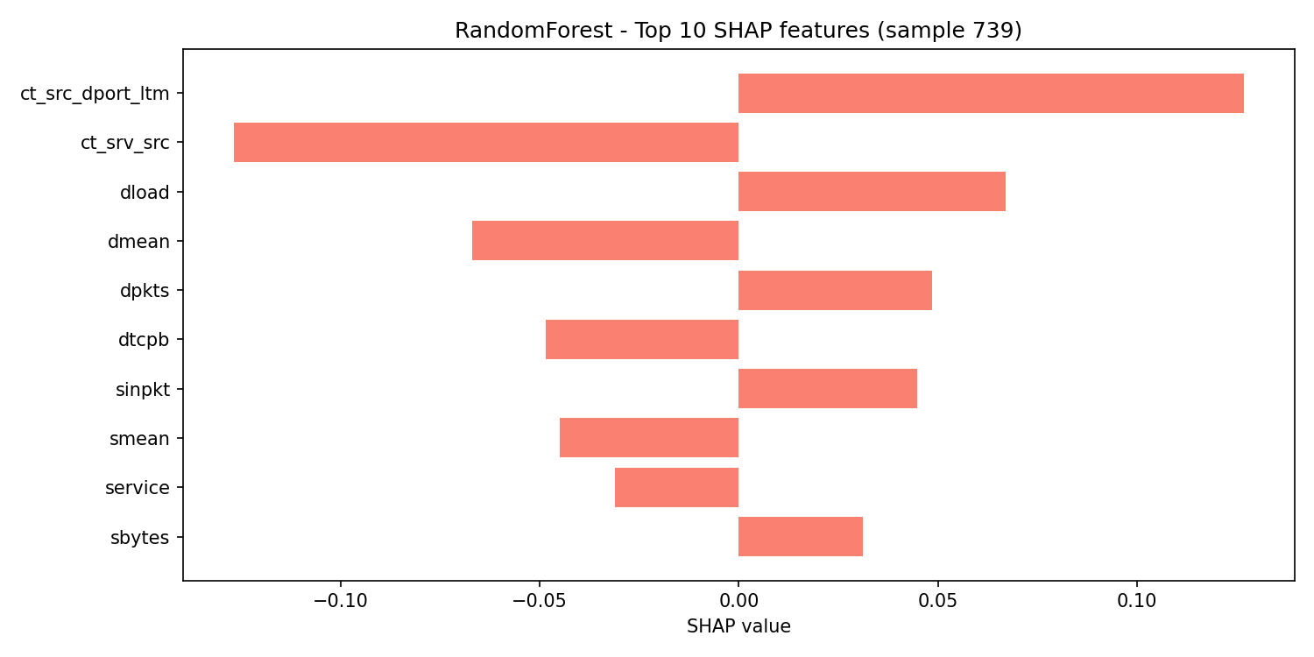
Fig. 11. SHAP for sample 739 – Random Forest

Slide 33
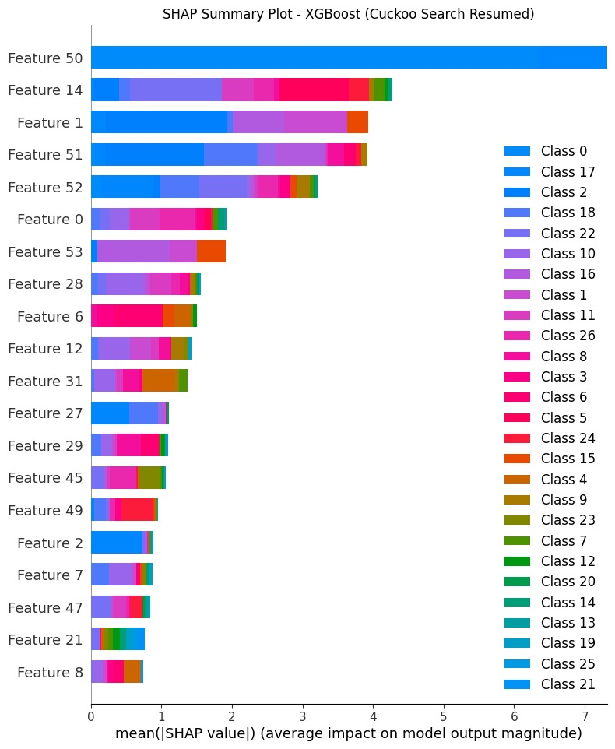
Fig. 12. Overall SHAP

Slide 34
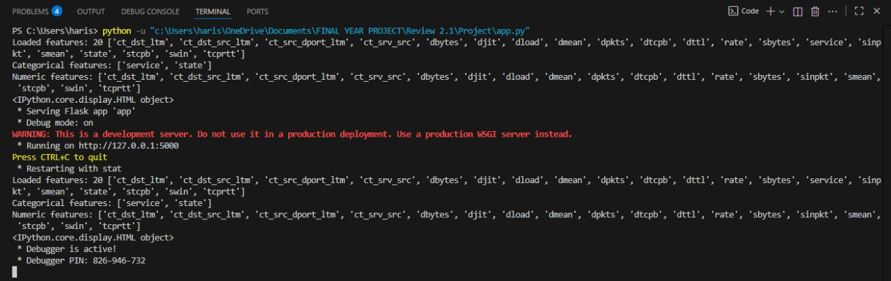
Review 2.1
Fig. 13. IP address generation

Slide 35
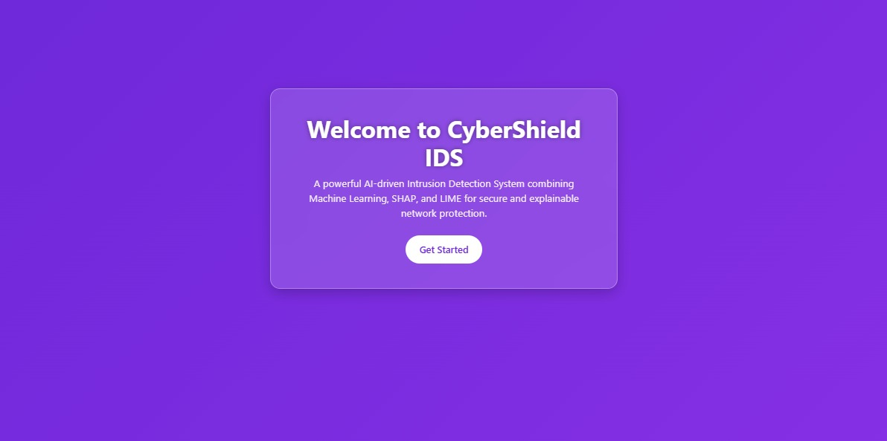
Fig. 14. UI starting

Slide 36
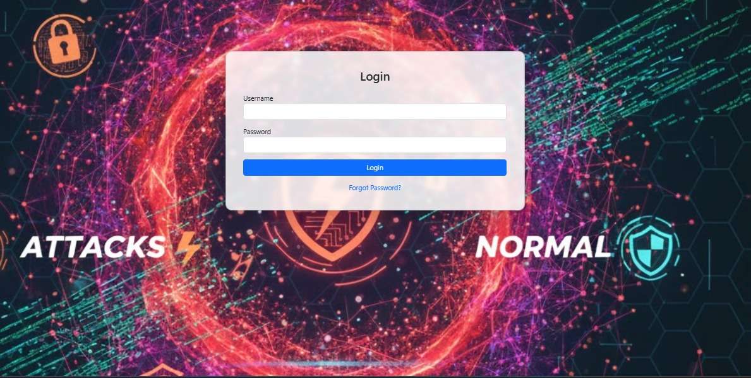
Fig. 15. Login Page

Slide 37
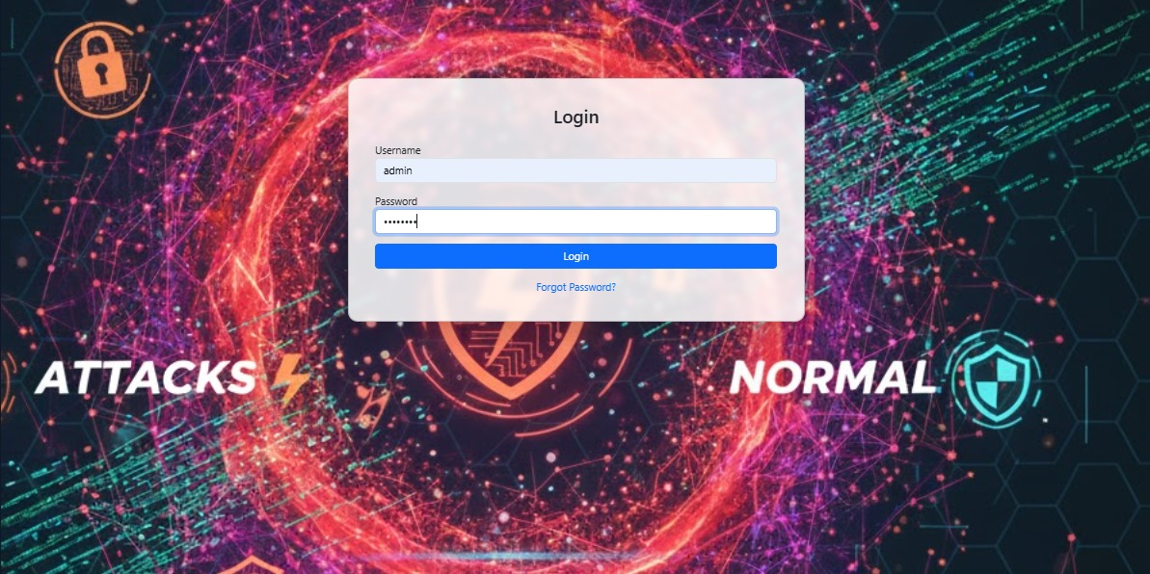
Fig. 16. Credentials entry

Slide 38
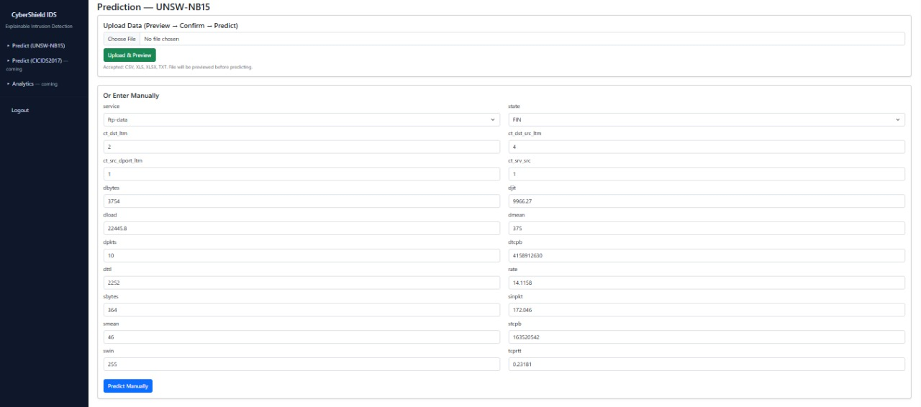
Fig. 17. UNSW-NB15 entry fields

Slide 39
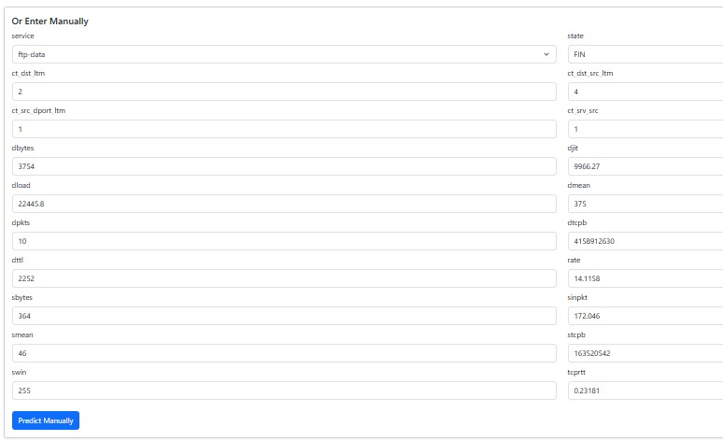
Fig. 18. Manual entry made

Slide 40
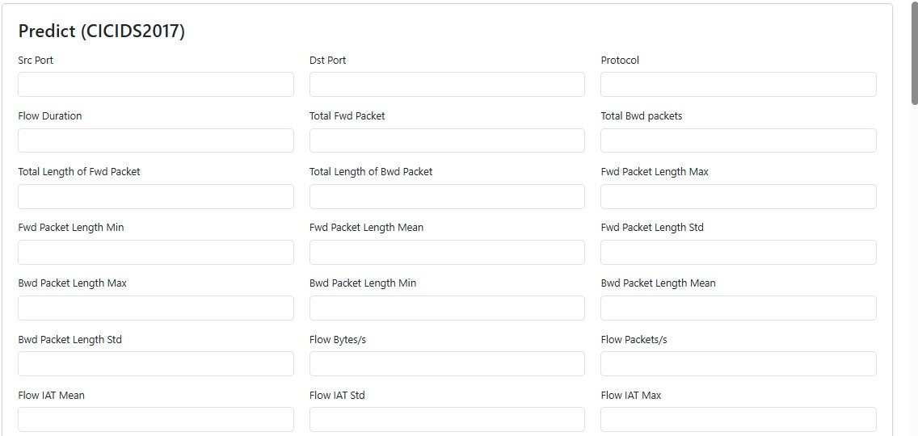
Fig. 19. CICIDS 2017 entry page

Slide 41
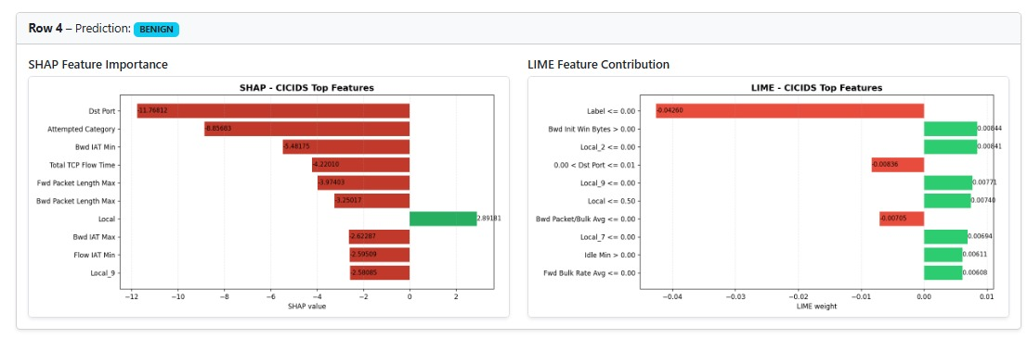
Fig. 20. CICIDS 2017 Visualization – Normal Sample

Slide 42
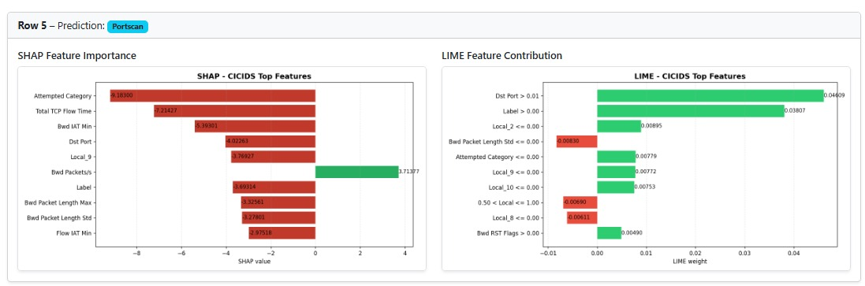
Fig. 21. CICIDS 2017 Visualization – Attack Sample

Slide 43
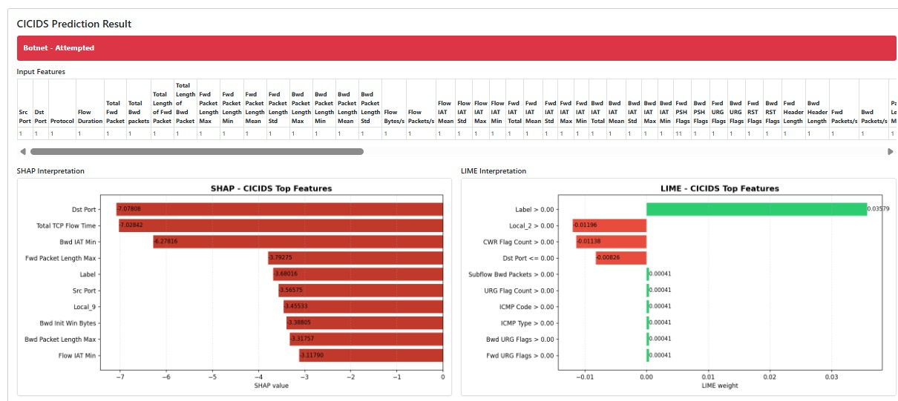
Fig. 22. Manual entry results

Slide 44
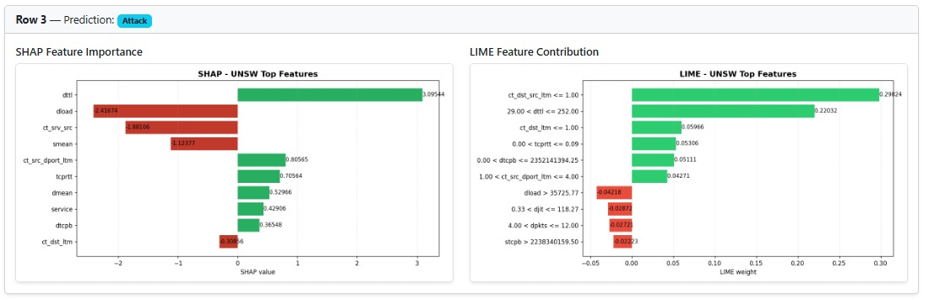
Fig. 23. UNSW-NB15 Visualization – Attack Sample

Slide 45
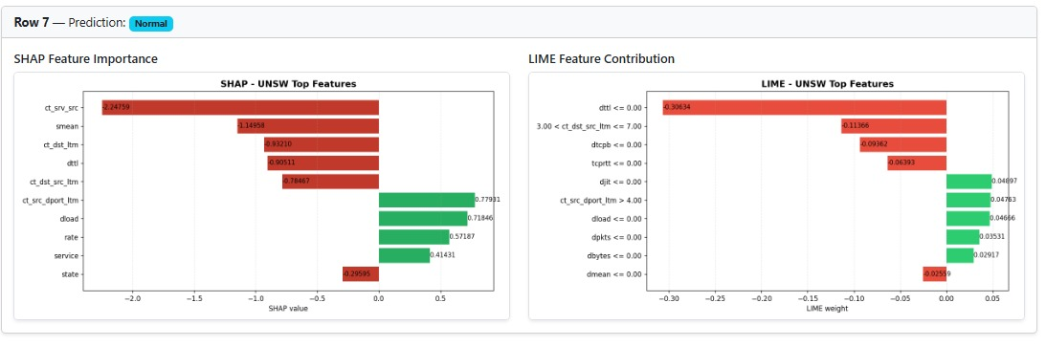
Fig. 24. UNSW-NB15 Visualization – Normal sample

Slide 46
Validation and Testing
UI is tested for several sample cases, and the results are verified against ground truth data
XAI – No standard evaluation metrics; only subjective measures
UX is validated by several end users and the survey results are consolidated.

Slide 47
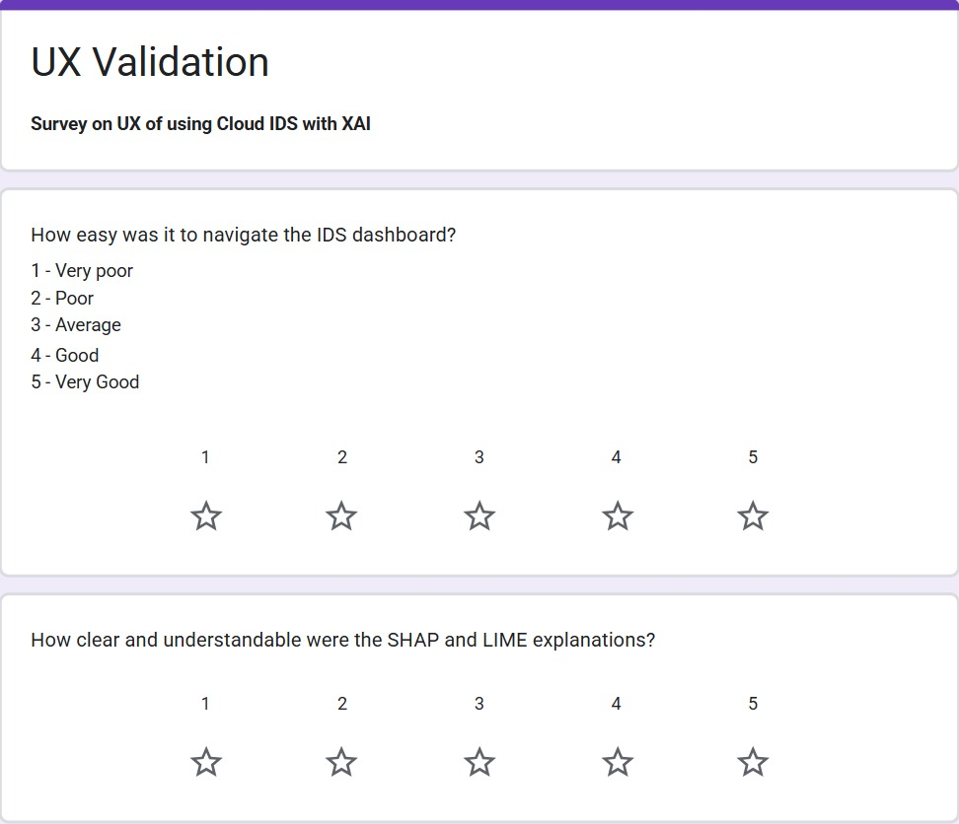
Fig. 25. Survey Page

Slide 48
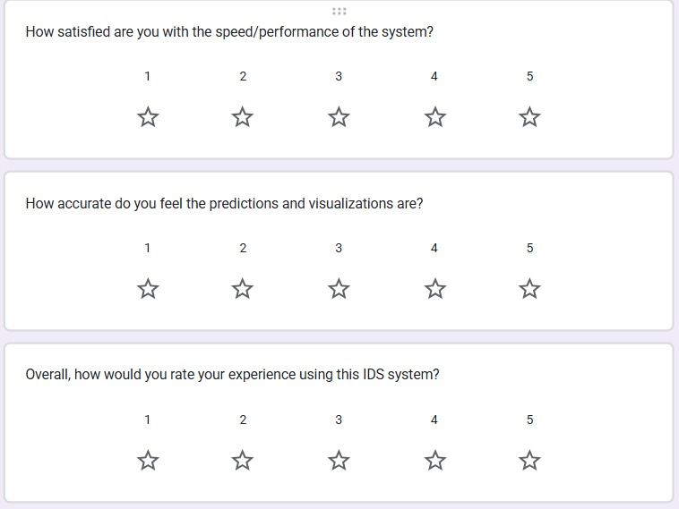
Fig. 26. Survey remaining questions

Slide 49
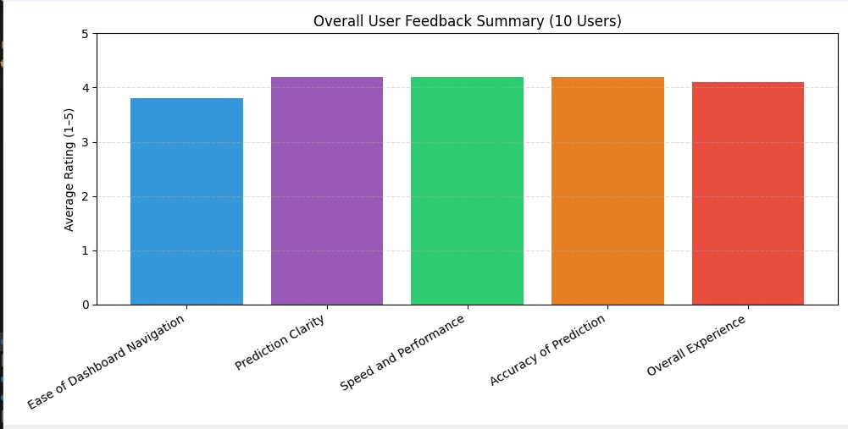
Fig. 27. Survey Consolidated results

Slide 50
Review 2.2: February 2026 – March 2026
Milestones and Deliverables: February 2026 - March 2026
Conduct live testing using synthetic or simulated network traffic to check the accuracy of final results
Final refinements, error corrections and IEEE report submission
Prepare presentation/demo for evaluation

Slide 51
Conclusion
The LIME and SHAP algorithms were implemented for an individual instance, and their explanations were visualized better with UI and were validated using the ground truth available. LIME is best suited for local explanations, and SHAP for global explanations.

Slide 52
References
[1] M. Bakro et al., "An Improved Design for a Cloud Intrusion Detection System Using Hybrid Features Selection Approach With ML Classifier," in IEEE Access, vol. 11, pp. 64228-64247, 2023, doi: 10.1109/ACCESS.2023.3289405.
[2] O. Arreche, T. R. Guntur, J. W. Roberts and M. Abdallah, "E-XAI: Evaluating Black-Box Explainable AI Frameworks for Network Intrusion Detection," in IEEE Access, vol. 12, pp. 23954-23988, 2024, doi: 10.1109/ACCESS.2024.3365140.
[3] A. Rawal, J. McCoy, D. B. Rawat, B. M. Sadler and R. S. Amant, "Recent Advances in Trustworthy Explainable Artificial Intelligence: Status, Challenges, and Perspectives," in IEEE Transactions on Artificial Intelligence, vol. 3, no. 6, pp. 852-866, Dec. 2022, doi: 10.1109/TAI.2021.3133846.
[4] H. Yan et al., "Automatic Evasion of Machine Learning-Based Network Intrusion Detection Systems," in IEEE Transactions on Dependable and Secure Computing, vol. 21, no. 1, pp. 153-167, Jan.-Feb. 2024, doi: 10.1109/TDSC.2023.3247585.
[5] N. Moustafa, N. Koroniotis, M. Keshk, A. Y. Zomaya and Z. Tari, "Explainable Intrusion Detection for Cyber Defences in the Internet of Things: Opportunities and Solutions," in IEEE Communications Surveys & Tutorials, vol. 25, no. 3, pp. 1775-1807, thirdquarter 2023, doi: 10.1109/COMST.2023.3280465.
[6] C. M. Hartman and B. P. Rimal, "Interpretable Machine Learning for Mitigating Feature-Driven Attacks," in IEEE Transactions on Technology and Society, vol. 6, no. 2, pp. 220-230, June 2025, doi: 10.1109/TTS.2025.3531780.
[7] J. Kumar Samriya, S. Kumar, M. Kumar, H. Wu and S. Singh Gill, "Machine Learning-Based Network Intrusion Detection Optimization for Cloud Computing Environments," in IEEE Transactions on Consumer Electronics, vol. 70, no. 4, pp. 7449-7460, Nov. 2024, doi: 10.1109/TCE.2024.3458810.
[8] S. Das et al., "Network Intrusion Detection and Comparative Analysis Using Ensemble Machine Learning and Feature Selection," in IEEE Transactions on Network and Service Management, vol. 19, no. 4, pp. 4821-4833, Dec. 2022, doi: 10.1109/TNSM.2021.3138457.
[9] M. Nadeem, A. Arshad, S. Riaz, S. S. Band and A. Mosavi, "Intercept the Cloud Network From Brute Force and DDoS Attacks via Intrusion Detection and Prevention System," in IEEE Access, vol. 9, pp. 152300-152309, 2021, doi: 10.1109/ACCESS.2021.3126535

Slide 53
[10] S. Neupane et al., "Explainable Intrusion Detection Systems (X-IDS): A Survey of Current Methods, Challenges, and Opportunities," in IEEE Access, vol. 10, pp. 112392-112415, 2022, doi: 10.1109/ACCESS.2022.3216617
[11] S. Das et al., "Network Intrusion Detection and Comparative Analysis Using Ensemble Machine Learning and Feature Selection," in IEEE Transactions on Network and Service Management, vol. 19, no. 4, pp. 4821-4833, Dec. 2022, doi: 10.1109/TNSM.2021.3138457.
[12] Pandya, Suhag. "Robust Blockchain and Artificial Intelligence-Based Efficient Techniques for Network Intrusion Detection System to Improve Cybersecurity." 2025 3rd International Conference on Integrated Circuits and Communication Systems (ICICACS). IEEE, 2025
[13] ] H. Manthena, S. Shajarian, J. C. Kimmell, M. Abdelsalam, S. Khorsandroo and M. Gupta, "Explainable Artificial Intelligence (XAI) for Malware Analysis: A Survey of Techniques, Applications, and Open Challenges," in IEEE Access, vol. 13, pp. 61611-61640, 2025, doi: 10.1109/ACCESS.2025.3555926.
[14] P. Ferreira, E. Martins, J. Silva and P. Teixeira, "Feature Selection and XGBoost for Enhanced Intrusion Detection: A Comparative Study Across Benchmark Datasets," 2025 13th International Symposium on Digital Forensics and Security (ISDFS), Boston, MA, USA, 2025, pp. 1-6, doi: 10.1109/ISDFS65363.2025.11012060.
[15] N. Moustafa and J. Slay, "UNSW-NB15: a comprehensive data set for network intrusion detection systems (UNSW-NB15 network data set)," 2015 Military Communications and Information Systems Conference (MilCIS), Canberra, ACT, Australia, 2015, pp. 1-6, doi: 10.1109/MilCIS.2015.7348942.
[16] Pansari, Nikunj, Shourya Srivastava, and Mayank Agarwal. "Attack classification using machine learning on unsw-nb 15 dataset using xgboost feature selection & ablation analysis." 2024 IEEE 9th International Conference for Convergence in Technology (I2CT). IEEE, 2024.
[17] Yang, Jikun. "A new attacks intrusion detection model based on deep learning in software-defined networking environments." 2024 4th International Conference on Machine Learning and Intelligent Systems Engineering (MLISE). IEEE, 2024.
[18] Telidevara, Madhuri, and D. Kothandaraman. "Improving intrusion detection in internet of things networks with feed-forward neural networks based on the unsw-nb15 dataset." 2023 14th International Conference on Computing Communication and Networking Technologies (ICCCNT). IEEE, 2023.

Slide 54
[19]R. N. Mulawade, C. Garth and A. Wiebel, "Explainable Artificial Intelligence (XAI) for Methods Working on Point Cloud Data: A Survey," in IEEE Access, vol. 12, pp. 146830-146851, 2024, doi: 10.1109/ACCESS.2024.3472872.
[20] A. Namrita Gummadi, J. C. Napier and M. Abdallah, "XAI-IoT: An Explainable AI Framework for Enhancing Anomaly Detection in IoT Systems," in IEEE Access, vol. 12, pp. 71024-71054, 2024, doi: 10.1109/ACCESS.2024.3402446
[21] D. Hooshyar and Y. Yang, "Problems With SHAP and LIME in Interpretable AI for Education: A Comparative Study of Post-Hoc Explanations and Neural-Symbolic Rule Extraction," in IEEE Access, vol. 12, pp. 137472-137490, 2024, doi: 10.1109/ACCESS.2024.3463948.
[22] S. Ahmed, M. S. Kaiser, M. Shahadat Hossain and K. Andersson, "A Comparative Analysis of LIME and SHAP Interpreters With Explainable ML-Based Diabetes Predictions," in IEEE Access, vol. 13, pp. 37370-37388, 2025, doi: 10.1109/ACCESS.2024.3422319.
[23] G. Elkhawaga, O. M. Elzeki, M. Abu-Elkheir and M. Reichert, "Why Should I Trust Your Explanation? An Evaluation Approach for XAI Methods Applied to Predictive Process Monitoring Results," in IEEE Transactions on Artificial Intelligence, vol. 5, no. 4, pp. 1458-1472, April 2024, doi: 10.1109/TAI.2024.3357041.

Slide 55
Thank You

